Slide 1


Slide 2




Slide 3
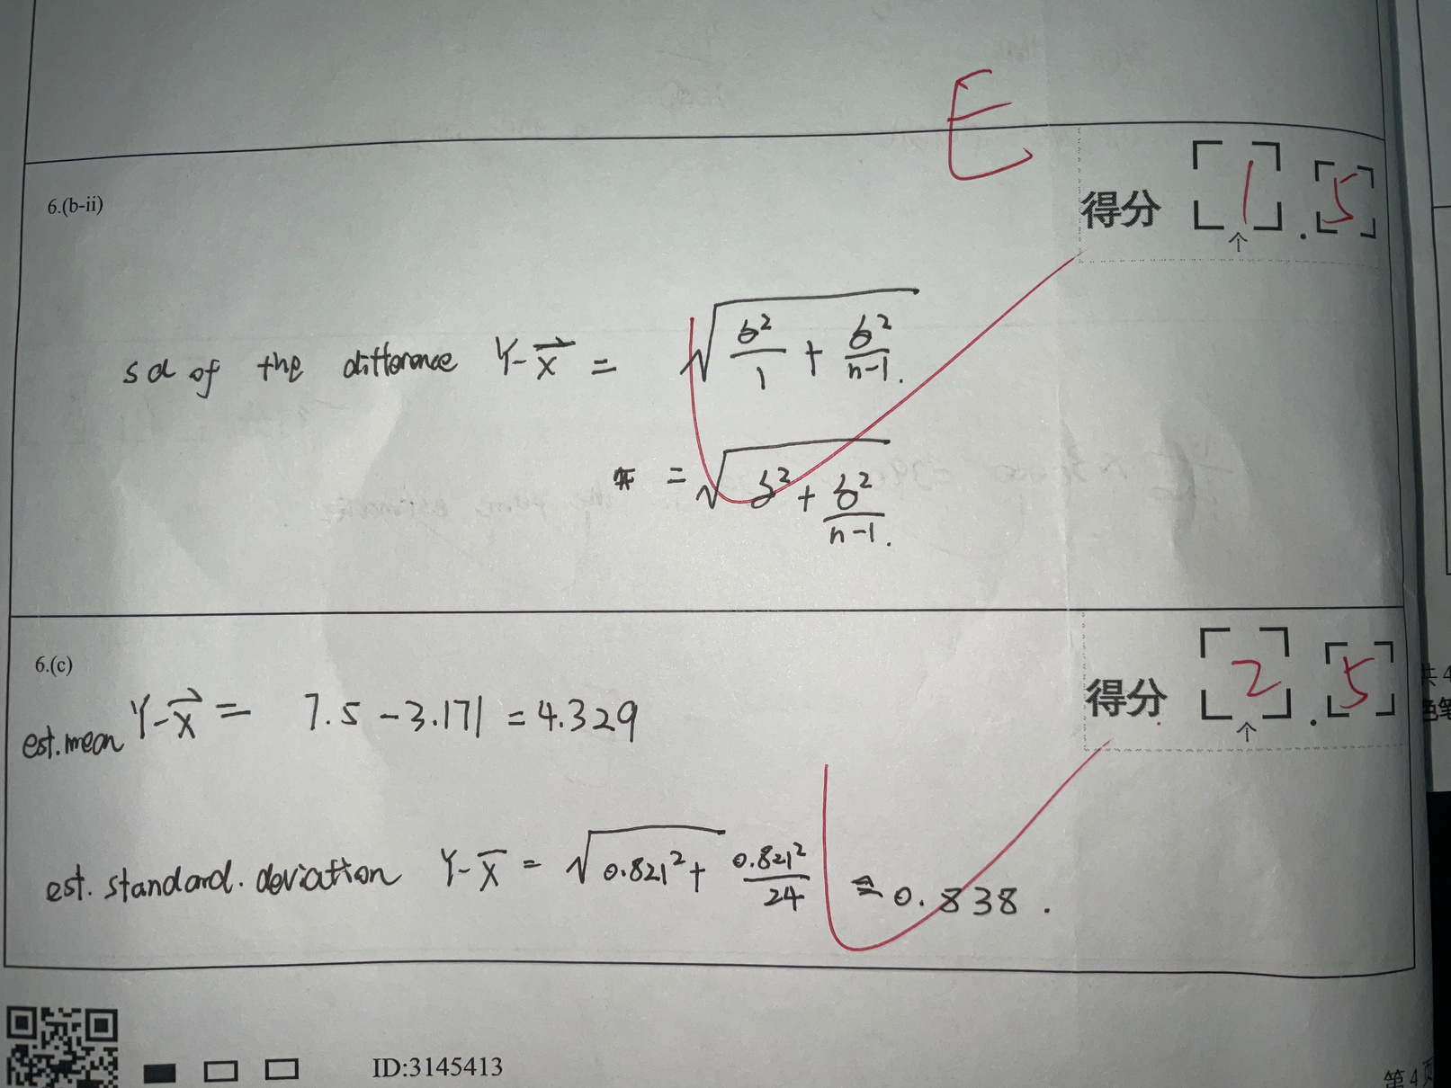





Slide 4










MNIST Handwritten digit classification with CNN
Tang Jiarui, Wang Zihao

Slide 5
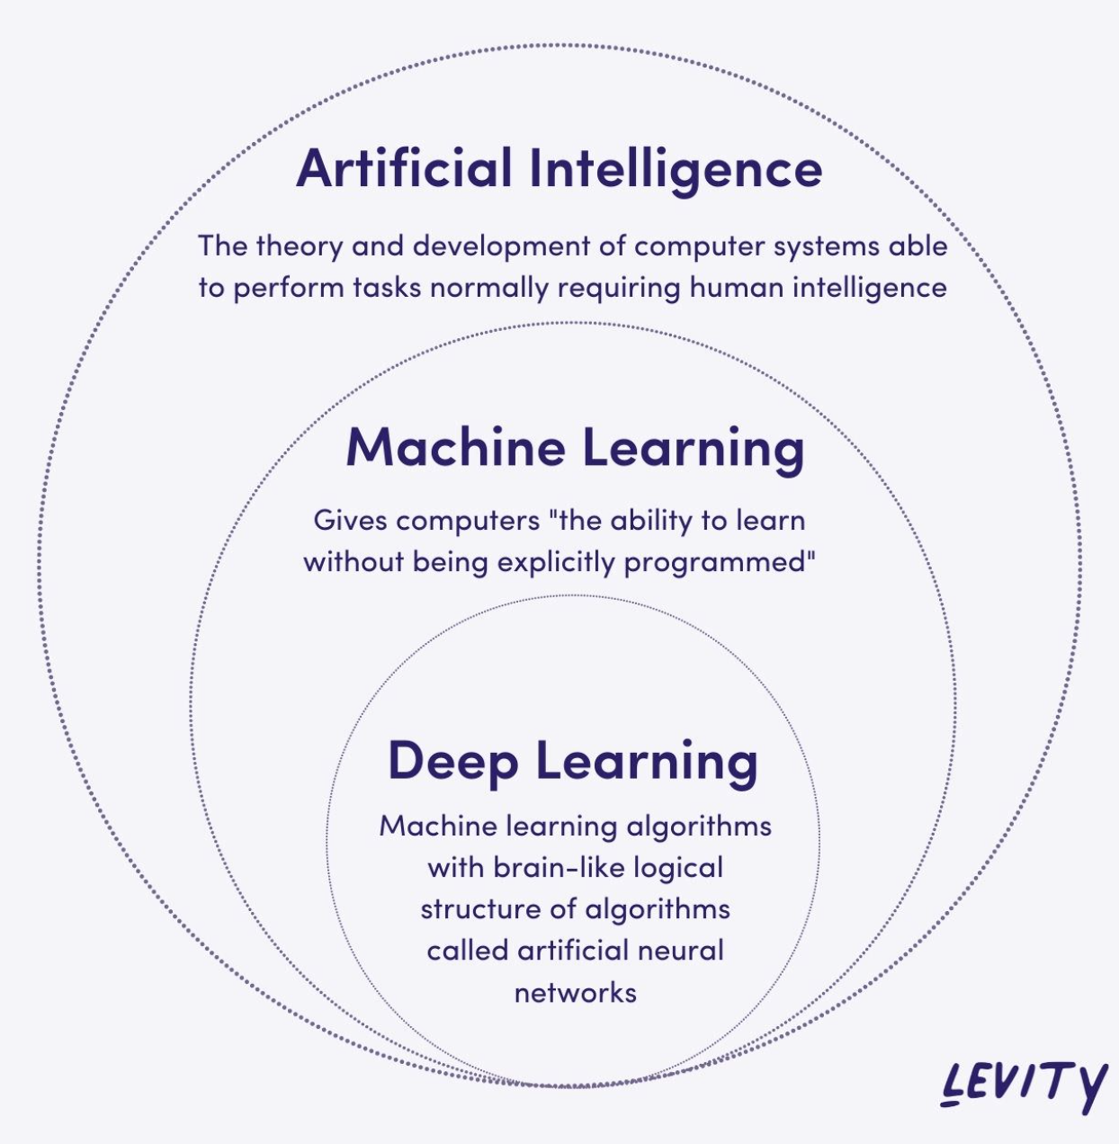

Introduction
·Artificial Intelligence (AI)
·Machine Learning (ML)

Slide 6
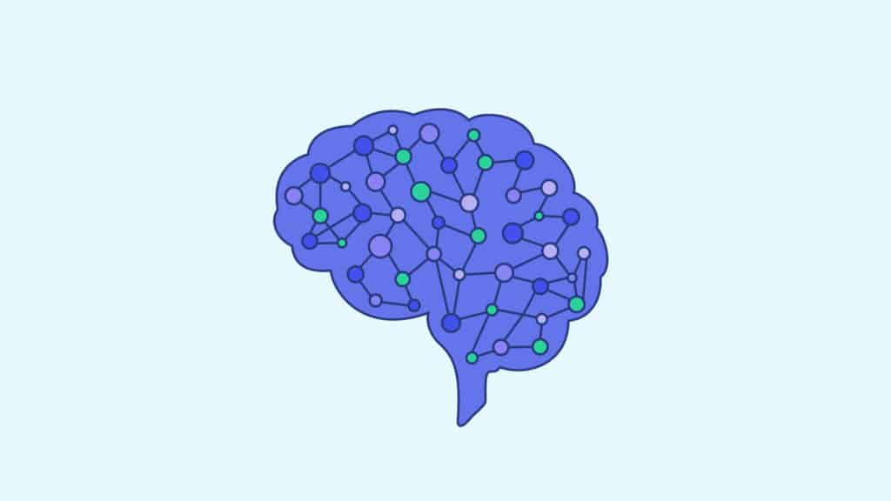
Neural Network
A neural network is a machine learning program, or model, that makes decisions in a manner similar to the human brain, by using processes that mimic the way biological neurons work together to identify phenomena, weigh options and arrive at conclusions.
(IBM)

Slide 7
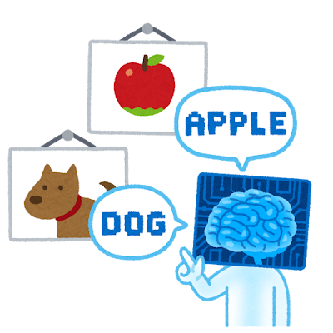
Neural Network
Computer vision
Applications:
Computer vision
Speech recognition
Natural language processing
Recommendation engines
(AWS)

Slide 8
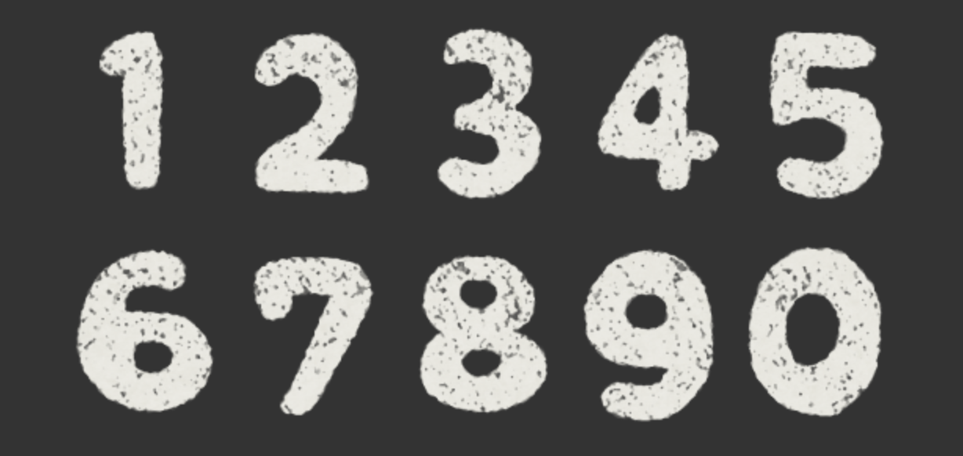
MNIST Handwritten Digit Classification Using Convolutional Neural Network (CNN)

Slide 9
1) Data set
2) Model architecture
3) Training process
4) Test and result
5) Discussion
6) Future work
Overview

Slide 10
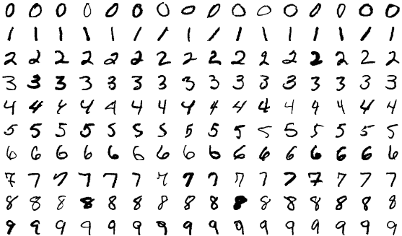
Data Set
The MNIST database (Modified National Institute of Standards and Technology database) is a large database of handwritten digits that is commonly used for training various image processing systems. (Wikipedia)
black and white
28 * 28
anti-aliased - grayscale

Slide 11

Data Set
Training set: 60,000
Testing set: 10,000

Slide 12
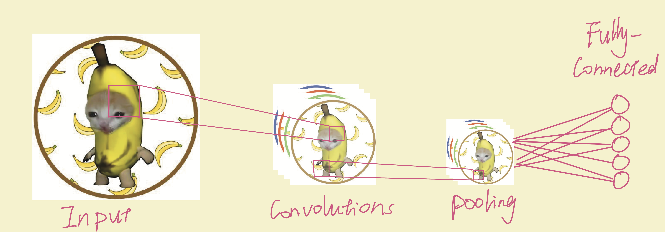
Model Architecture
CNN - a kind of nueral network, heigher efficiency & accuracy
convolutional layer, max pooling layer, & fully connetcted layer

Slide 13
Model Architecture
10 neurons
64 kernels
64 kernels
64 kernels
64 neurons
0
32 neurons
1
2
3
Input Image
4
5
6
7
8
9
Convolutional Layer1
+ Max Pooling Layer1
Convolutional Layer2
+ Max Pooling Layer2
Convolutional Layer3
+ Max Pooling Layer3

Slide 14
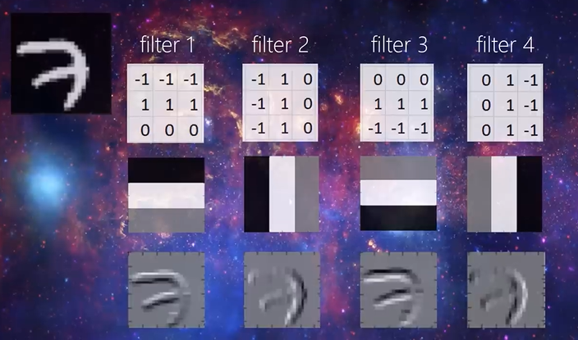

Model Architecture
3 Convolutional Layers, extract characteristics from numbers
64 kernels, scan through image
64 activation maps

Slide 15
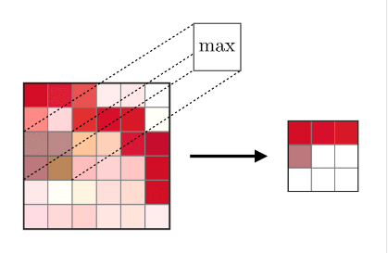
Model Architecture
Max Pooling Layer, finish training faster
4*4 filters with stride 4 extract a maximum number

Slide 16
Model Architecture
10 neurons
64 kernels
64 kernels
64 kernels
64 neurons
0
32 neurons
1
2
3
Input Image
4
5
6
7
8
9
Convolutional Layers1
+ Max Pooling Layers1
Convolutional Layers2
+ Max Pooling Layers2
Convolutional Layers3
+ Max Pooling Layers3

Slide 17
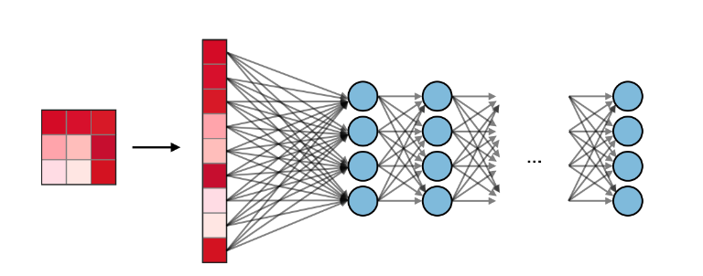
Model Architecture
Flatten activation maps to a straight line
Input for Fully Connected Layer
2 Layers: 64 neurons, 32 neurons
FC - prediction and decision

Slide 18
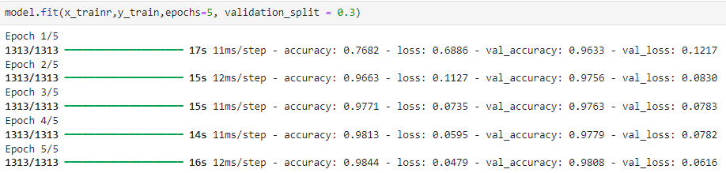
Training Process
Validation split: 0.3 ---- 42,000 training, 18,000 validation

Slide 19
Training Process
1. changed kernel size from 3*3 to 2*2 and 4*4
2. reduce the number of neurons in each dense layer
3. use only one convolutional layer instead of three
4. changing the number of kernels from 64 to 5 - accuracy 98% to 91%

Slide 20

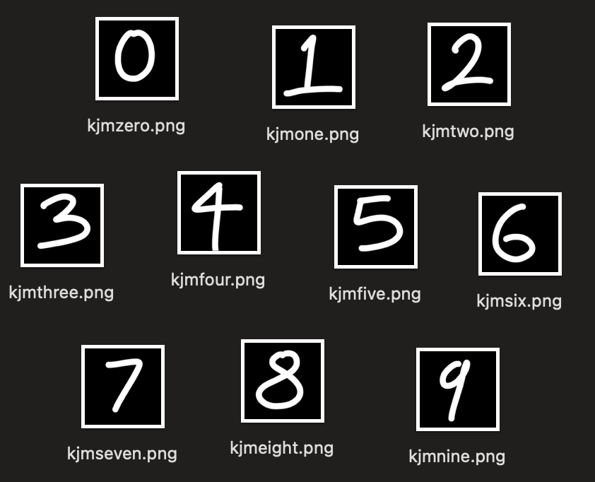
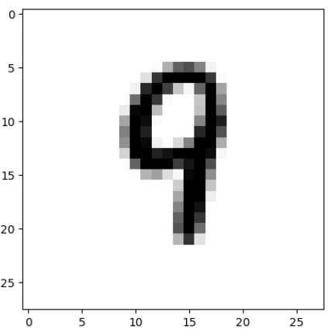
Test and Result
10 Subjects
normalization
50% ～ 90%
77%±13.375%
28*28
grayscale

Slide 21


Discussion
7 -- 1
cultural differences

Slide 22

Future Work
improve model
our own data set
application

Slide 23





illustrations from irasutoya
Music: Pikuseru no Yume
composed by Suno
lyric by ChatGPT
Questions?
AWS (2023). What is a neural network? AI and ML guide - AWS. [online] Amazon Web Services, Inc. Available at: https://aws.amazon.com/what-is/neural-network/.
‌
Coursera Staff. (2024). Machine Learning vs. Neural Networks: What’s the Difference? [online] Available at: https://www.coursera.org/articles/machine-learning-vs-neural-networks [Accessed 12 June. 2024].
Geeksforgeeks. (2024). What is a neural network? [online] Availavle at: https://www.geeksforgeeks.org/neural-networks-a-beginners-guide/ [Accessed 12 June. 2024].
NVIDIA Developer. (2018). Artificial Neural Network. [online] Available at: https://developer.nvidia.com/discover/artificial-neural-network [Accessed 12 June. 2024].
‌
IBM (2023). What Are Neural Networks? [online] Available at: https://www.ibm.com/topics/neural-networks [Accessed 11 June. 2024].
O'shea, K. and Nash, R. (2015). An Introduction to Convolutional Neural Networks. [online] Available at: https://arxiv.org/pdf/1511.08458 [Accessed 12 June. 2024].
‌
‌Wikipedia (2019). MNIST database. [online] Wikipedia. Available at: https://en.wikipedia.org/wiki/MNIST_database [Accessed 12 June. 2024].
‌
Wikipedia. (2024). Neural network (machine learning). [online] Available at: https://en.wikipedia.org/wiki/Neural_network_(machine_learning) [Accessed 11 June. 2024].
Wolfewicz, A. (2022). Deep learning vs. machine learning – What’s the difference? [online] levity.ai. Available at: https://levity.ai/blog/difference-machine-learning-deep-learning.
‌
Afshine Amidi and Shervine Amidi. (2019). Convolutional Neural Networks cheatsheet. [online] Available at: https://stanford.edu/~shervine/teaching/cs-230/cheatsheet-convolutional-neural-networks

